Slide 1
Anime tracking site
Developing a software to help the users track their anime watch list

Slide 2
TABLE OF CONTENTS
01
02
03
04
05
06
SERVICES
Existing examples
profits
Aims!
Let’s run the code!
The dataset

Slide 3
01
SERVICES

Slide 4

What does the program offer?
Signing up and signing in to save your changes.
a variety of anime titles to add to your lists.
Already built in lists (want to watch, watching, watched)
You can search the anime you want to add based on its name, genre and the year the anime started in.
An admin account in which the admin can ad ads, send notifications and add animes to the list.
Anime recommendations.

Slide 5

Email validation using regular expression (RE)
It looks for one or more non-@ characters, followed by an @, followed by one or more non-@ characters, followed by a ., followed by one or more non-@ characters.

Slide 6
Recommendations
The recommendation choice was made using countervecorizer and cosine_similarity from sklearn library.
It was a fun process.

Slide 7
02
Existing examples

Slide 8
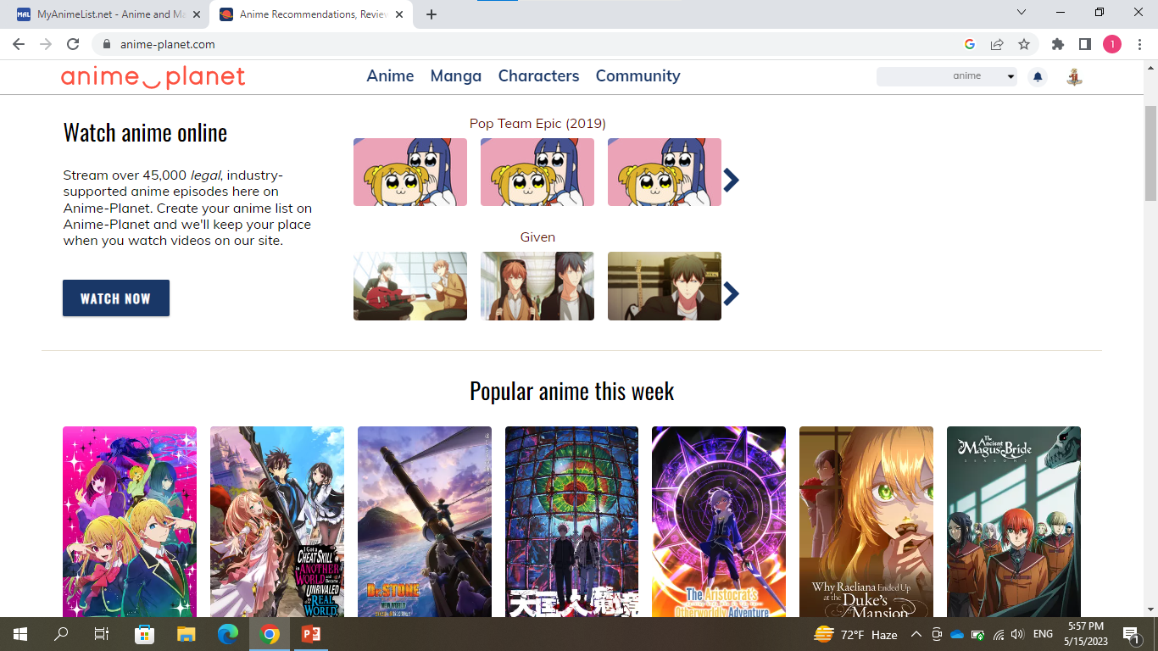
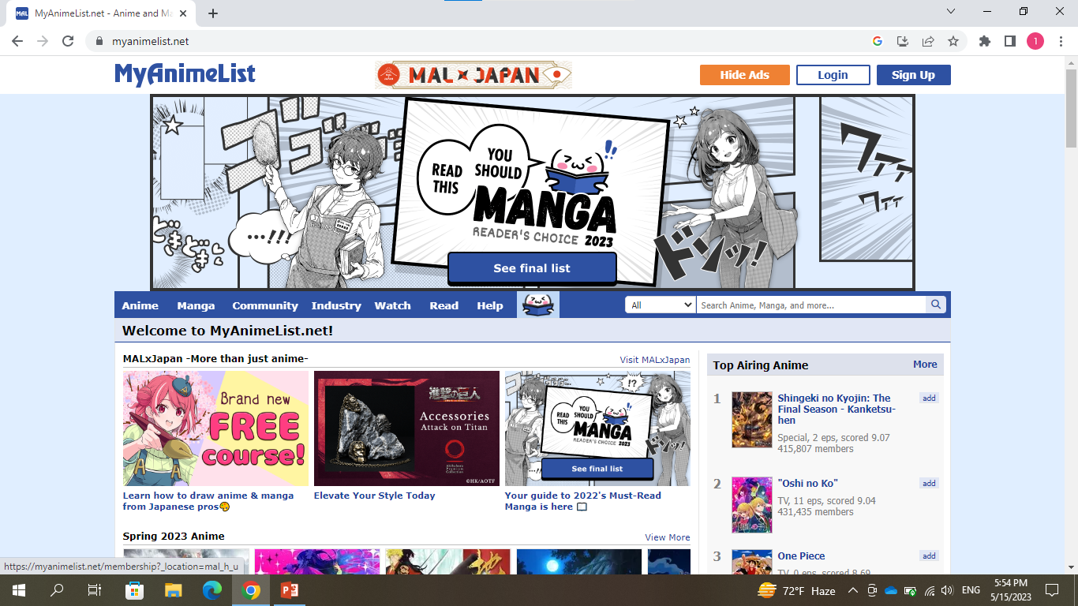
The most well known sites:
Anime planet
My anime list

Slide 9
03
profits

Slide 10
How does these sites gain profit?
“ads”
“subscriptions for an ad free experience”
“agreements with main streaming companies”
“streaming some episodes legally on their sites”

Slide 11
04
The dataset
I chose a dataset from Kaggle, preprocessed it into what I need and used it

Slide 12
Preprocessing
dropped nine columns I didn’t need.
filled all the empty cells in the content warning column with “none”.
filled some cells on in the episodes column -the empty ones seem to be the ones that were not completed in the time this dataset was created- then dropped all the remaining null cells.
Made all the columns in lower case, except for the type column I converted it to upper case.
There seemed to be an unwanted spaces in the type column cells so I removed them.
To make sure there is no more white spaces using the strip function.
I used the “CountVectorizer” from sklearn to get the names of all the features in some columns, in content warning there was 19 feature including the “none”.
Finally, I downloaded the dataset in an excel form to run it in my code.

Slide 13
05
Aims!

Slide 14
what changes are we planning to make?
Make a better recommendation system

Slide 15
Let’s run the code together!

Slide 16
THANKS
Do you have any questions?
lydalala17@eng.just.edu.jo
Please keep this slide for attribution

